Slide 1
Innovation Center , KSRMCE
LearnIt module on Introduction to Internet Of Things

Slide 2

Internet of Things : what is it, and should you care ?

Slide 3
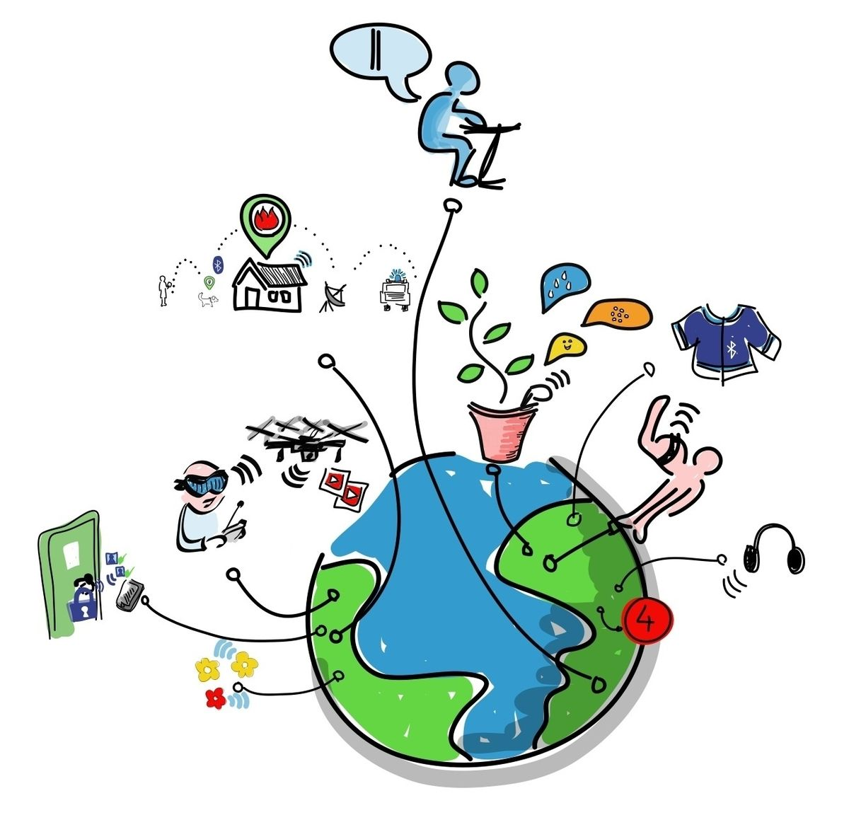
The Definition
It is a network of Things
—each embedded with sensors
— which are connected to the Internet
Thus, they can share information with each other in ways that allow for the automation of many tasks
Internet + Things

Slide 4
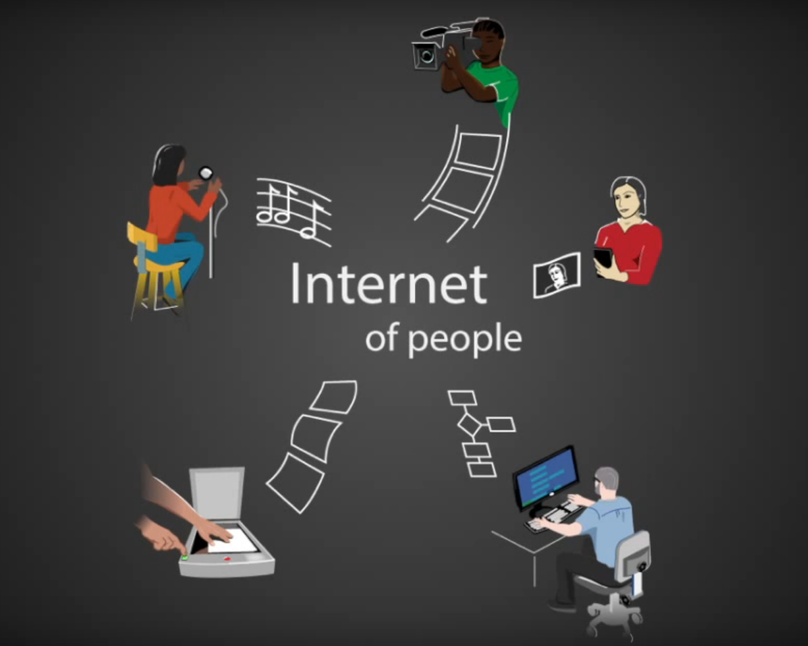
Internet
The large system of connected computers around the world that allows people to share information and communicate with each other.

Slide 5
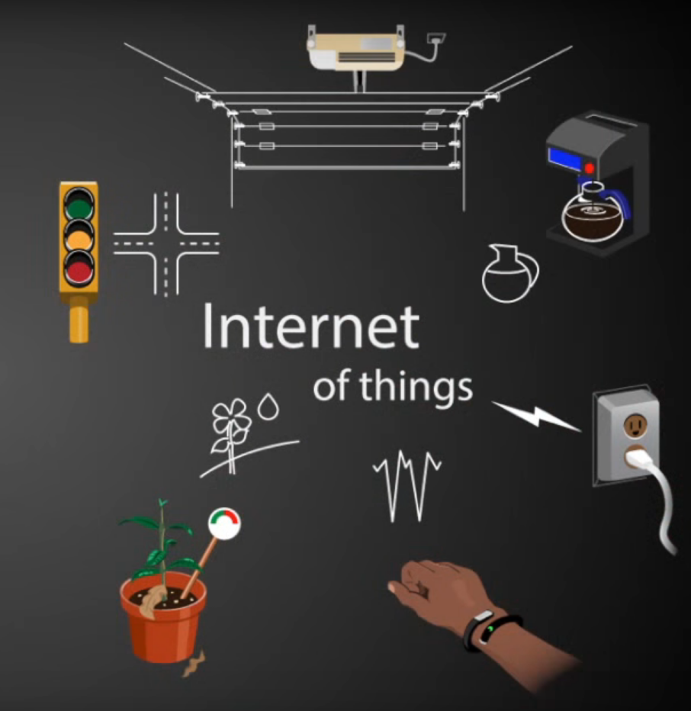
It’s about Connecting Things
Thing : An object or Entity that cannot be named specifically

Slide 6
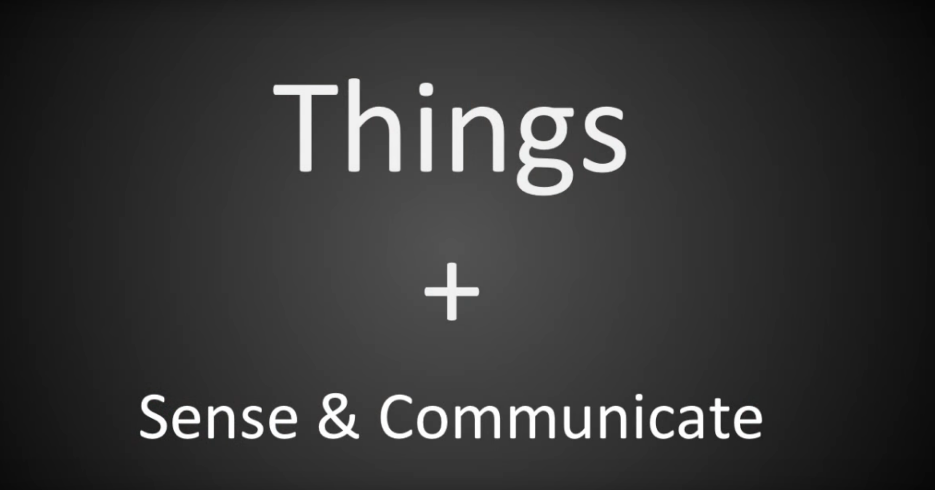
How things can talk to each other ?

Slide 7
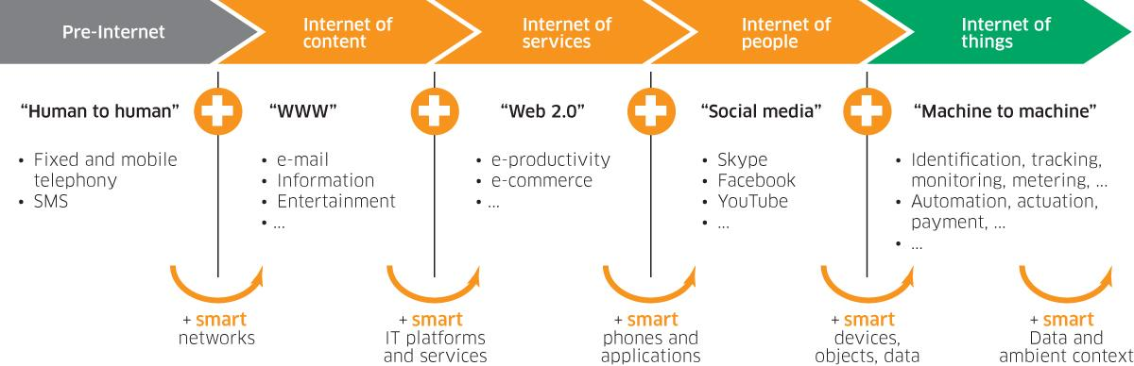
Internet of Things - Evolution

Slide 8
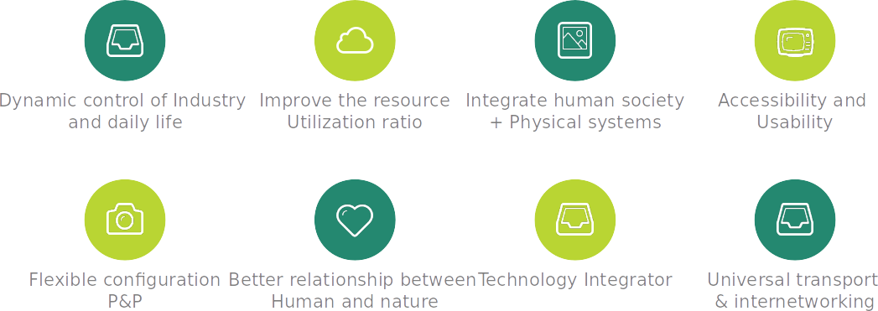
Why Internet of Things

Slide 9
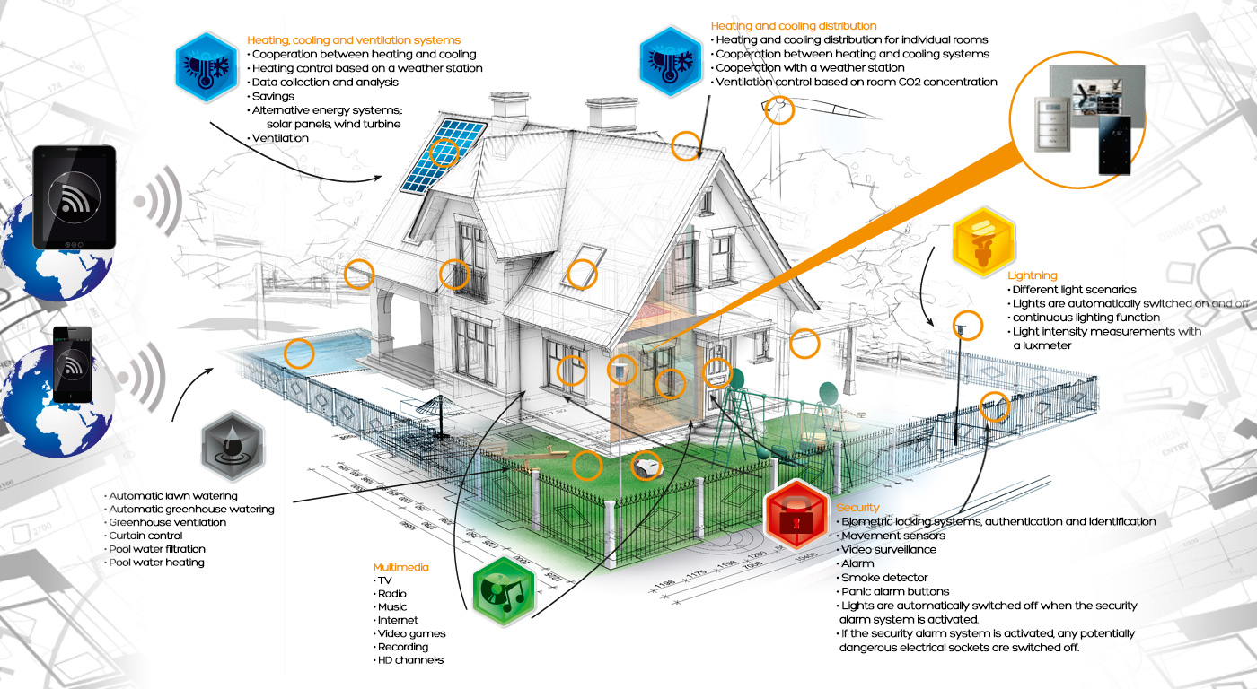
Smart Home

Slide 10
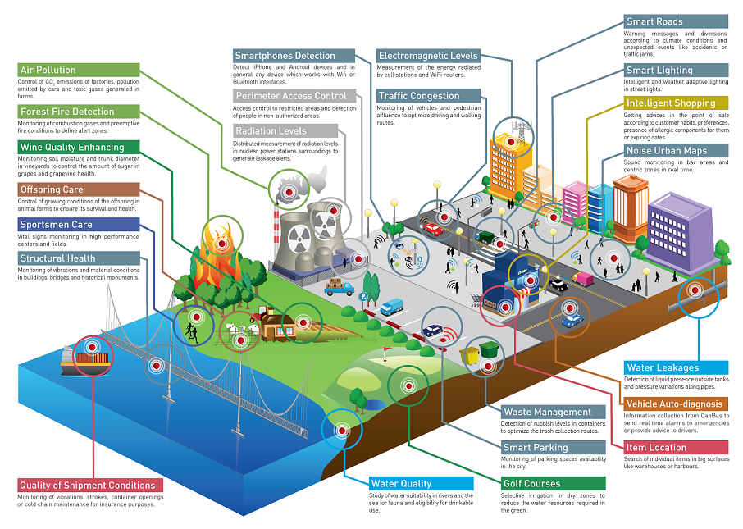
Smart City

Slide 11
Few Products Already in the Market

Slide 12
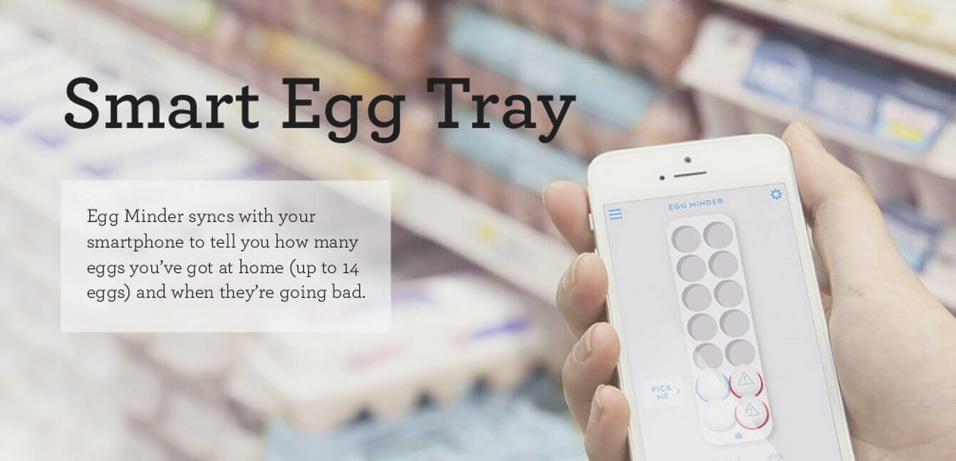

Slide 13


Slide 14
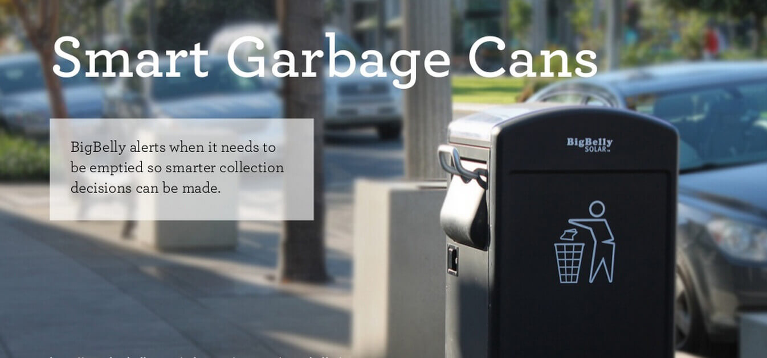

Slide 15
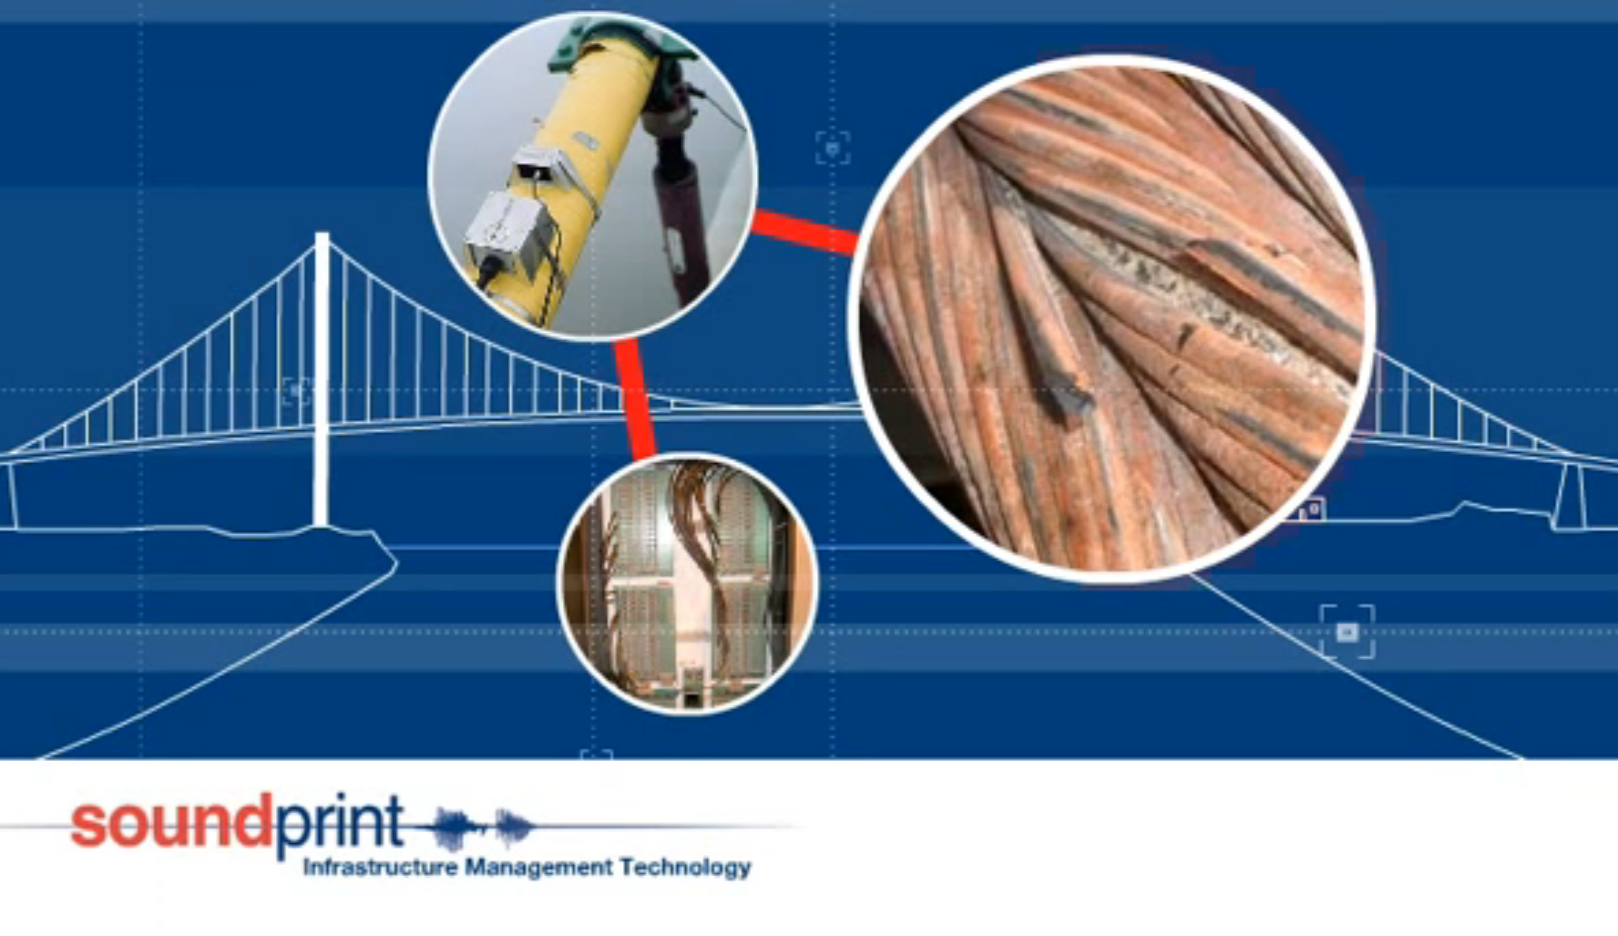

Slide 16
IOT Technologies

Slide 17
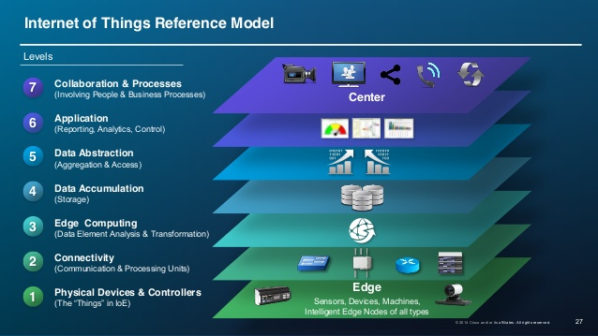

Slide 18
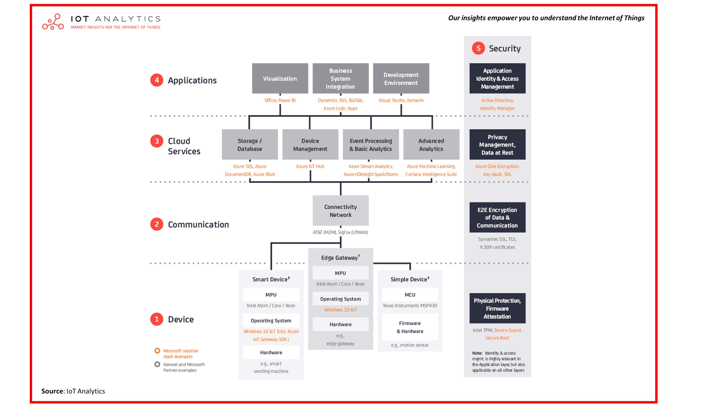
Generalized 5 layer model of an End to End IOT Solution

Slide 19
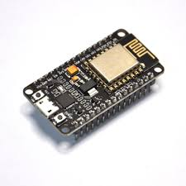
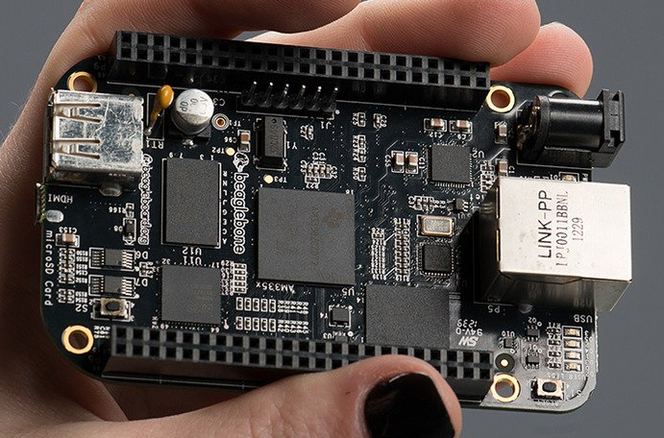
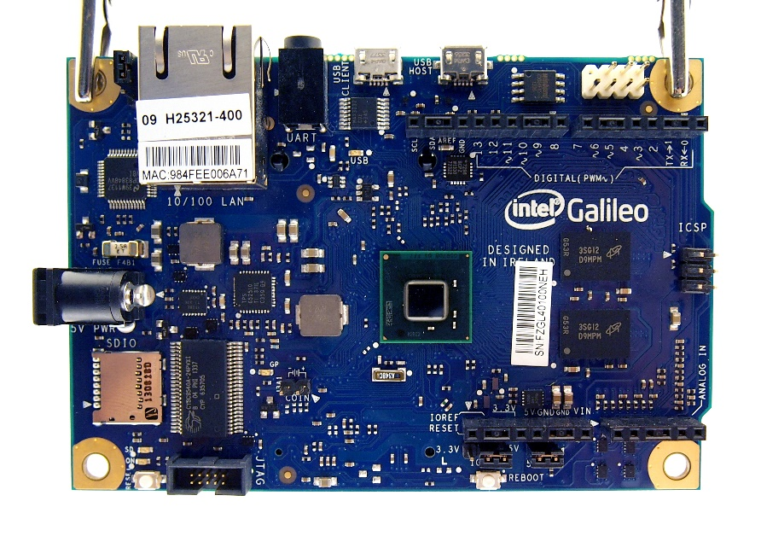
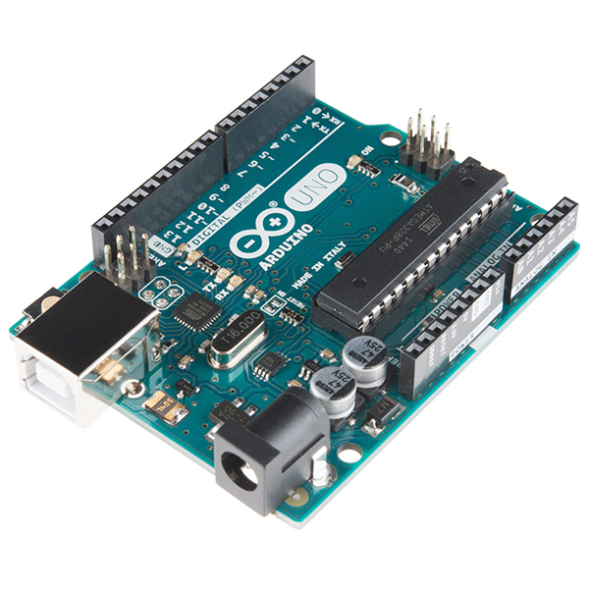
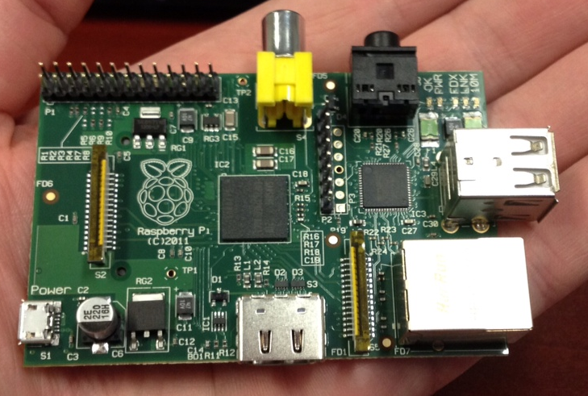
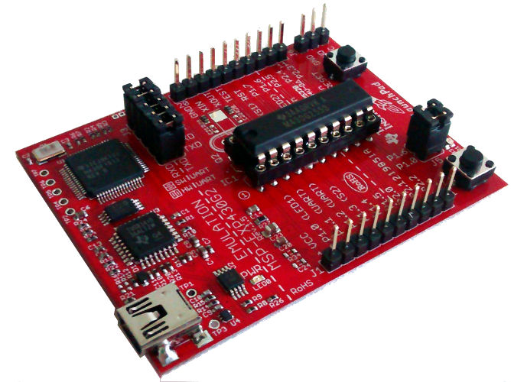
Devices : Controllers
Beaglebone Black
Intel - Galileo
NodeMCu
Arduino
MSP430

Slide 20
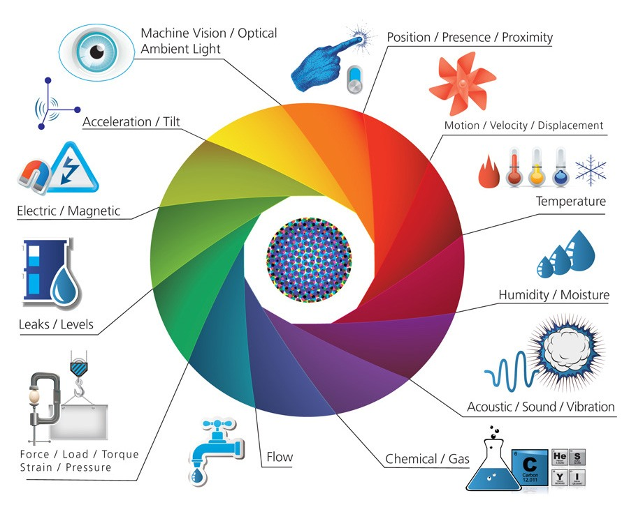
Devices : Sensor + Actuators

Slide 21
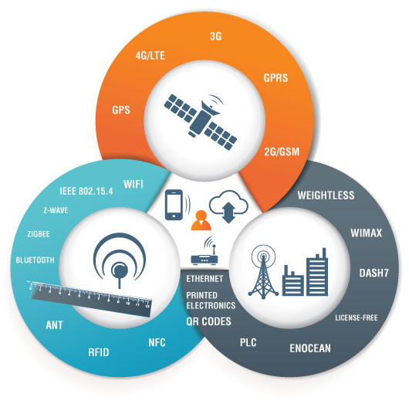
Communication
Notes:
Personal or local area Network, Wide Area Network , Industrial Area

Slide 22
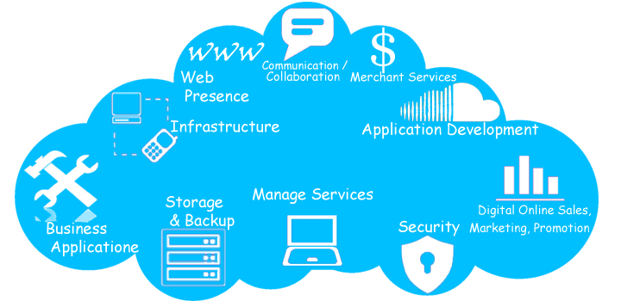
Cloud Services
Own Vs Cloud Service Providers
Simple HTTP Server
Various CSP’s are
Adafruit IO
AWS IoT
IBM BlueMix
Thingspeak

Slide 23
Protocols
MQTT
HTTP
HTTP : Hypertext Transfer Protocol
MQTT : Message Queue Telemetry Transport
COAP : Constrained Application Protocol
AMQP: Advanced Message Queuing Protocol
COAP
AMQP

Slide 24
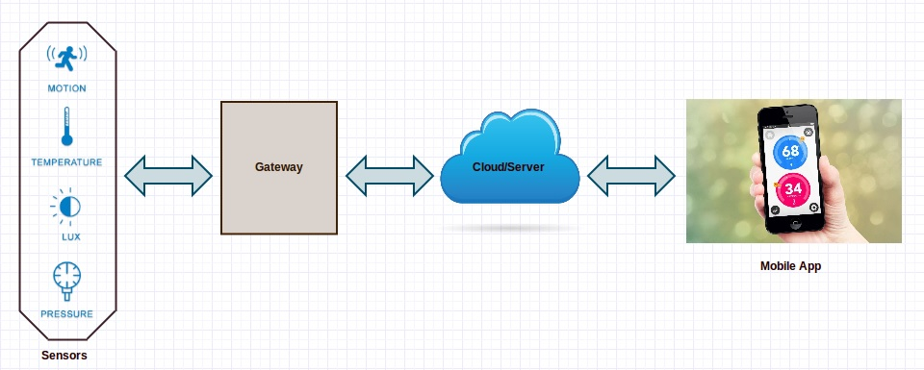
Conclude

Slide 25

Information Search and Analysis

Slide 26

Thankyou…
Queries ?

